Slide 1
Image Scraping and Classification Project
Presented by : Salman Pradhan

Slide 2
OBJECTIVE
We have undertaken this project to classify images catagories scrapped from Amazon.com. By doing small small modification in above code, we can scrap images of any commercial websites and classify images of different catagories such as family photos classifier,vehicle classifier,animal classifier etc.

Slide 3
Problem Statement
The idea behind this project is to build a deep learning-based Image Classification model on images that will be scraped from e-commerce portal. This is done to make the model more and more robust.
This task is divided into two phases: Data Collection and Mode Building.
Data Collection Phase: In this section, we scrape images from e-commerce portal, Amazon.com. The clothing categories used for scraping will be:Sarees (women),Trousers (men),Jeans (men).
We scrape images of these 3 categories and build your data from it. That data will be provided as an input to your deep learning problem. We scrap 200 images of each categories.
Model Building Phase: After the data collection and preparation is done, we build an image classification model that will classify between these 3 categories mentioned above

Slide 4
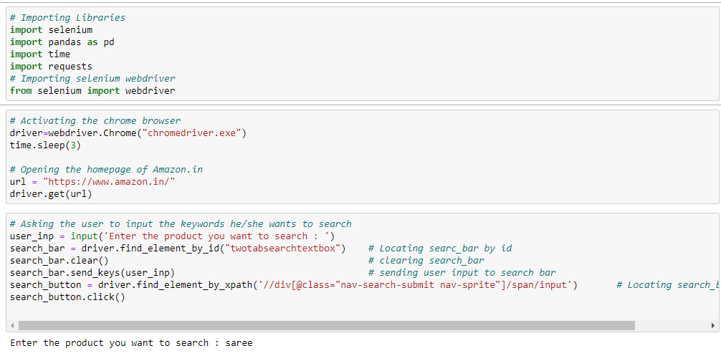
Data collection
First we import libraries and goes to Amazon.com and scrap images
After scrapping images ,we save them in our googledrive for model building purpose.

Slide 5

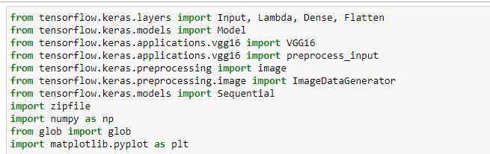
PREPROCESSING OF THE DATA
After images uploaded to google drive,we make our model by using googlecolab.we import necessary libraries and mount the google drive.

Slide 6
Images are in jpeg format and their sizes range between 5 kb to 10 kb.
As we use transfer learning(VGG16) to solve this classificationproject,we have to make our image size (224,224,3).

Slide 7
MODEL Building
1.Understand business problem
2.Scrapping images and save it in google drive
3.Data analysis
4.Visualization with cv2
5.Data preprocessing
6.Feature scaling
7.Model bulding with transfer learning technique(VGG16)

Slide 8
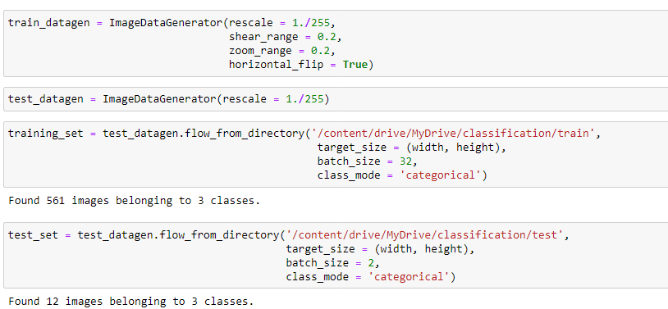
DATA MODELLING
We divide the dataset in train and test folder like below and scaling down its value betwwn 0 to 1 because our convergence will be faster.

Slide 9
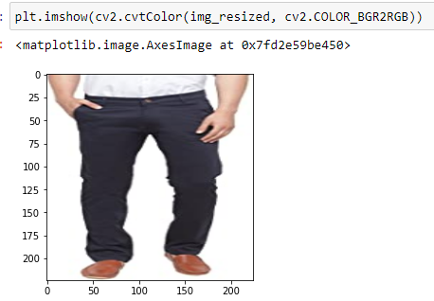
DATA VISUALIZATIONS
Sample image

Slide 10
Key metrics for solving the project
1.we have to solve this classification problem statement by VGG16.
2.So we have to make our image size (224,224,3).
3.We use Softmax activation function in the last layer and we use Adam optimizer for better accuracy.

Slide 11
FUTURE SCOPE
The current project classify images of different catagories.
We are planning to add the following features in the future:
By doing small small modification in above code, we can scrap images of any commercial websites and classify images of different catagories such as family photos classifier,vehicle classifier,animal classifier etc

Slide 12
Thank You

